Slide 1
Querying Wikidata with a glimpse of SPARQL
Thorsten Butz
Notes:
# Abstract
Querying Wikidata with a glimpse of SPARQL
Wikidata represents the underlying basement of Wikipedia, it's the collaboratively edited
knowledge base filling up Wikipedia with data.
Querying Wikidata enables you to gain access to to a universe of information,
just in case you know how to answer the right questions.
This session provides an insight to wikidata/wikimedia queries by SPARQL, the semantic
query language from W3C.
After you watched this, you will be able to embed SPARQL queries inside your PowerShell
code.

Slide 2
Notes:
Thank you!

Slide 3
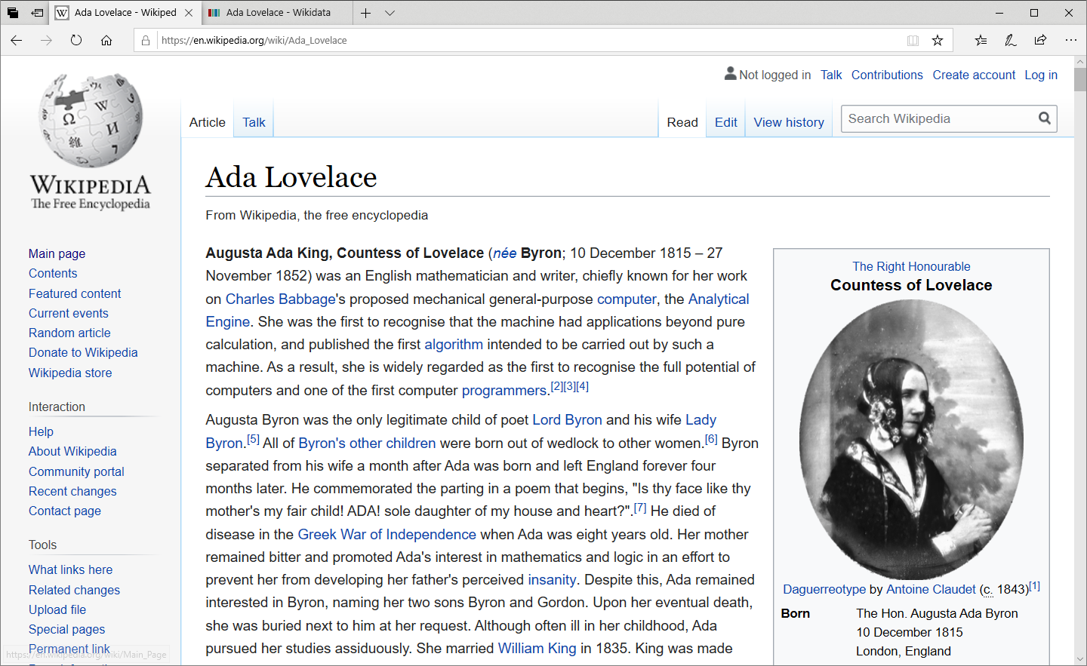
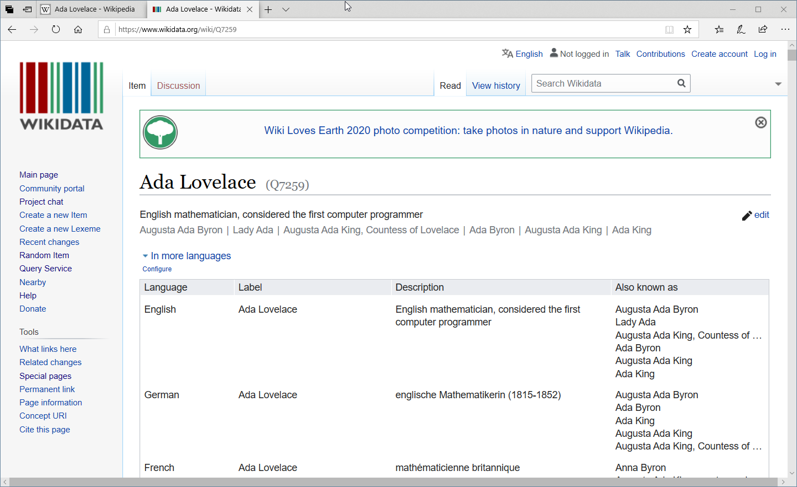
get-help about_wikidata
Notes:
Screenshots:
https://en.wikipedia.org/wiki/Ada_Lovelace
https://www.wikidata.org/wiki/Q7259
What is Wikidata?
"Wikidata is a knowledge database. It contains millions of statements, such as “the capital of Canada is Ottawa”, or “the Mona Lisa is painted in oil paint on poplar wood”, or “gold has a melting point of 1,064.18 degrees Celsius”."
https://www.wikidata.org/wiki/Wikidata:SPARQL_tutorial#Grouping

Slide 4
# Searching for someone like Ada ...
SELECT ?programmer ?date_of_birth ?programmerLabel WHERE {
SERVICE wikibase:label { bd:serviceParam wikibase:language "[AUTO_LANGUAGE],en". }
?programmer wdt:P106 wd:Q5482740;
wdt:P31 wd:Q5;
wdt:P21 wd:Q6581072;
wdt:P569 ?date_of_birth.
FILTER("1801-01-01"^^xsd:dateTime <= ?date_of_birth &&
?date_of_birth <= "1900-12-31"^^xsd:dateTime).
}
Notes:
The query:
https://w.wiki/RWj

Slide 5
# Searching for someone like Ada ...
SELECT ?programmer ?date_of_birth ?programmerLabel WHERE {
SERVICE wikibase:label { bd:serviceParam wikibase:language "[AUTO_LANGUAGE],en". }
# Who has "occupation" "programmer"?
?programmer wdt:P106 wd:Q5482740;
# "instance of" "human"
wdt:P31 wd:Q5; # "sex or gender" "female"
wdt:P21 wd:Q6581072; # "date of birth"
wdt:P569 ?date_of_birth.
# Show only programmers from the 19th century
FILTER("1801-01-01"^^xsd:dateTime <= ?date_of_birth &&
?date_of_birth <= "1900-12-31"^^xsd:dateTime).
}
Notes:
The query:
https://w.wiki/RWf

Slide 6
DEMO
Notes:
# Demo A: Ada Lovelace
# Searching for someone like Ada Lovelace ...
SELECT ?programmer ?date_of_birth ?programmerLabel WHERE {
SERVICE wikibase:label {
bd:serviceParam wikibase:language "[AUTO_LANGUAGE],en".
}
# Who has "occupation" "programmer"?
?programmer wdt:P106 wd:Q5482740;
# "instance of" "human"
wdt:P31 wd:Q5;
# "sex or gender" "femal"
wdt:P21 wd:Q6581072;
# "date of birth"
wdt:P569 ?date_of_birth.
# Show only programmers from the 19th century
FILTER("1801-01-01"^^xsd:dateTime <= ?date_of_birth &&
?date_of_birth <= "2000-12-31"^^xsd:dateTime).
}
ORDER BY ?date_of_birth

Slide 7
SPARQL Protocol and RDF Query Language
Semantic query language for databases
DATA STORD in Resource Description Framework (RDF) format
key technologoy of the "semantic web"
developed by
SELECT ?human WHERE {
# Semantic Triple
?human wdt:P31 wd:Q5. # "instance of" "human"
}
LIMIT 10
Notes:
What is SPARL?
"SPARQL is a language to formulate questions (queries) for knowledge databases. With the right database, a SPARQL query could answer questions like “what is the most popular tonality in music?” or “which character was portrayed by the most actors?” or “what’s the distribution of blood types?” or “which authors’ works entered the public domain this year?”."
Reference:
https://en.wikipedia.org/wiki/SPARQL
Tutorial:
https://www.wikidata.org/wiki/Wikidata:SPARQL_tutorial

Slide 8
Basics
VARIABLE =>
item =>
PropertY =>
prefix =>
?human
Q5 (human)
P31 (instance of)
wdt: (wikidata property)
wd: (wikidata item)
SELECT ?human WHERE {
# Semantic Triple
?human wdt:P31 wd:Q5. # "instance of" "human"
}
LIMIT 10
Notes:
Reference:
https://www.wikidata.org/wiki/Wikidata:SPARQL_tutorial

Slide 9
DEMO
Notes:
# Demo B: Star Trek
# Who performed Jean-Luc Picard?
SELECT ?item ?itemLabel WHERE {
SERVICE wikibase:label {
bd:serviceParam wikibase:language "[AUTO_LANGUAGE],en".
}
# "Dixon Hill" has performer JLP.
?item wdt:P175 wd:Q16276.
# "Jean-Luc Picard" has performer Patrick Stewart.
wd:Q16276 wdt:P175 ?item .
}
# What items have been created by Gene Roddenberry?
SELECT ?item ?itemLabel ?languages_spoken__written_or_signed
?languages_spoken__written_or_signedLabel ?date_of_birth
?country_of_citizenship ?country_of_citizenshipLabel
WHERE {
SERVICE wikibase:label {
bd:serviceParam wikibase:language "[AUTO_LANGUAGE],en".
}
?item wdt:P170 wd:Q191716.
?item wdt:P569 ?date_of_birth.
OPTIONAL { ?item wdt:P1412 ?languages_spoken__written_or_signed. }
OPTIONAL { ?item wdt:P27 ?country_of_citizenship. }
}

Slide 10
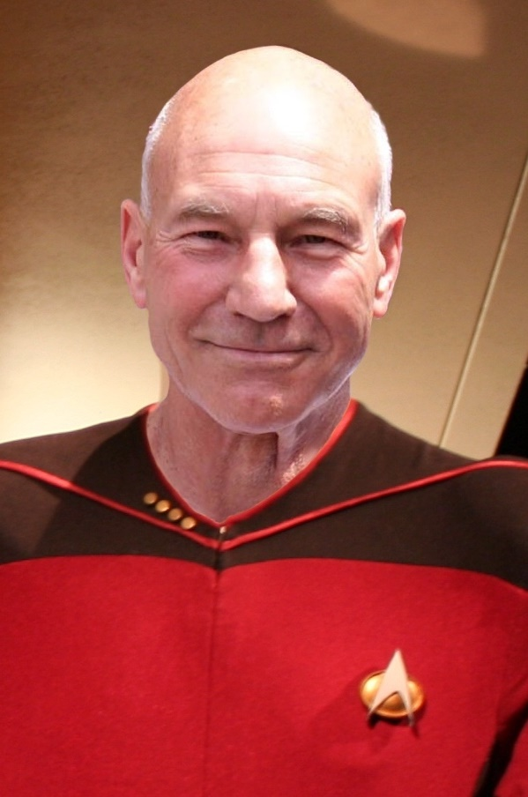
Subject - predicate - object
SELECT ?item ?itemLabel WHERE {
SERVICE wikibase:label {..}
# Dixon Hill has "performer" "Jean-Luc Picard".
?item wdt:P175 wd:Q16276.
}
SELECT ?item ?itemLabel WHERE {
SERVICE wikibase:label {..}
# Jean-Luc Picard has "performer" "Patrick Stewart".
wd:Q16276 wdt:P175 ?item.
}
Notes:
Reference:
https://en.wikipedia.org/wiki/Semantic_triple

Slide 11
DEMO
Notes:
# Demo C: People at Microsoft
# What was founded by Paul and Bill?
SELECT ?companyLabel WHERE {
SERVICE wikibase:label { bd:serviceParam wikibase:language "[AUTO_LANGUAGE],en". }
?company wdt:P112 wd:Q162005,
wd:Q5284.
}
# Microsoft employees
SELECT ?item ?itemLabel ?GitHub_username ?notable_workLabel WHERE {
SERVICE wikibase:label { bd:serviceParam wikibase:language "[AUTO_LANGUAGE],en". }
?item wdt:P108 wd:Q2283; # ? has employer MSFT
wdt:P2037 ?GitHub_username; # ? has a Github username
wdt:P800 ?notable_work. # ? has a notable work
}
You will find the complete set of example files here:
https://www.thorsten-butz.de/psconfeu2020/
https://github.com/psconfeu/2020

Slide 12
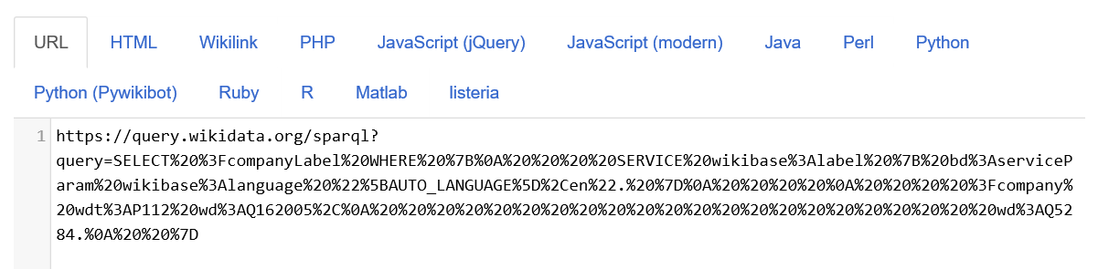
Query webservice (1)
curl.exe 'https://query.wikidata.org/sparql?query=SELECT%20%3FcompanyLabel%20WHERE%20%7B%0A%20%20%20%20SERVICE%20wikibase%3Alabel%20%7B%20bd%3AserviceParam%20wikibase%3Alanguage%20%22%5BAUTO_LANGUAGE%5D%2Cen%22.%20%7D%0A%20%20%20%20%0A%20%20%20%20%3Fcompany%20wdt%3AP112%20wd%3AQ162005%2C%0A%20%20%20%20%20%20%20%20%20%20%20%20%20%20%20%20%20%20%20%20%20%20wd%3AQ5284.%0A%20%20%7D'
Notes:
# The founder of MSFT. We had that before …
SELECT ?companyLabel WHERE {
SERVICE wikibase:label {
bd:serviceParam wikibase:language "[AUTO_LANGUAGE],en".
}
?company wdt:P112 wd:Q162005,
wd:Q5284.
}

Slide 13
Query webservice (2)
$sparql = @'
SELECT ?companyLabel WHERE {
SERVICE wikibase:label { bd:serviceParam wikibase:language "[AUTO_LANGUAGE],en". }
?company wdt:P112 wd:Q162005,
wd:Q5284.
}
'@
# XML
Invoke-RestMethod -Uri "https://query.wikidata.org/sparql?query=$sparql"
#CSV
Invoke-RestMethod -Uri "https://query.wikidata.org/sparql?query=$sparql"
-Headers @{'Accept' = 'text/csv' } | ConvertFrom-Csv
Notes:
The query:
https://w.wiki/Ryp

Slide 14
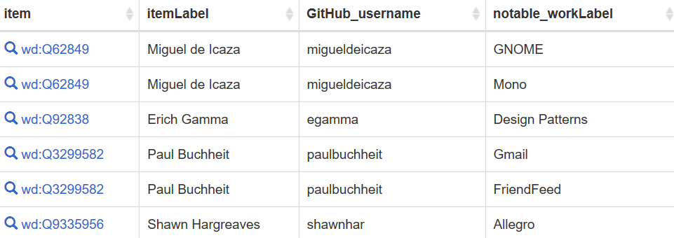
grouping
SELECT ?item ?itemLabel ?GitHub_username ?notable_workLabel WHERE {
SERVICE wikibase:label {..}
?item wdt:P108 wd:Q2283; # ? has employer MSFT
wdt:P2037 ?GitHub_username; # ? has a Github username
wdt:P800 ?notable_work. # ? has a notable work
}
Notes:
The query:
https://w.wiki/RaH

Slide 15
# Grouping results
SELECT ?item ?itemLabel ?GitHub_username
(group_concat(?notable_workLabel;separator=",") as ?arrNotableWork)
WHERE {
SERVICE wikibase:label {
bd:serviceParam wikibase:language "[AUTO_LANGUAGE],en".
?item rdfs:label ?itemLabel.
?notable_work rdfs:label ?notable_workLabel.
}
?item wdt:P108 wd:Q2283; # ? has employer MSFT
wdt:P2037 ?GitHub_username; # ? has a Github username
wdt:P800 ?notable_work. # ? has a notable work
}
GROUP BY ?item ?itemLabel ?GitHub_username having(count(?notable_workLabel) >= 2)
Notes:
The query:
https://w.wiki/Ryq

Slide 16
# Grouping results
SELECT ?item ?itemLabel ?GitHub_username
(group_concat(?notable_workLabel;separator=",") as ?arrNotableWork)
WHERE {
SERVICE wikibase:label {
bd:serviceParam wikibase:language "[AUTO_LANGUAGE],en".
?item rdfs:label ?itemLabel.
?notable_work rdfs:label ?notable_workLabel.
}
?item wdt:P108 wd:Q2283; # ? has employer MSFT
wdt:P2037 ?GitHub_username; # ? has a Github username
wdt:P800 ?notable_work. # ? has a notable work
}
GROUP BY ?item ?itemLabel ?GitHub_username having(count(?notable_workLabel) >= 2)
Notes:
The query:
https://w.wiki/RaM
You can also click on the WIKIDTA on the slide.

Slide 17
Summary
WIKIDATA is a GREAT RESOURCE
Powershell is NOT (YET) a 1st class citizen on the web
an object based shell aligns perfectly with webserviceS
get-demofile | start-trying
SPARQL 1.1 Overview (W3c recommendation) https://www.w3.org/TR/sparql11-overview/
Wikidata Query Service/User Manual https://www.mediawiki.org/wiki/Wikidata_Query_Service/User_Manual
Wikidata sparql tutorial https://www.wikidata.org/wiki/Wikidata:SPARQL_tutorial
Notes:
SPARQL Examples:
https://www.wikidata.org/wiki/Wikidata:SPARQL_query_service/queries/examples
https://www.w3.org/2009/Talks/0615-qbe/

Slide 18
one more thing ..
Notes:
Reference:
https://en.wikipedia.org/wiki/Stevenote

Slide 19
# Pubs in the neighborhood of HCC (Hannover Congress Centrum)
SELECT ?place ?placeLabel ?location ?distance
WHERE
{
SERVICE wikibase:label { bd:serviceParam wikibase:language "[AUTO_LANGUAGE],en" . }
SERVICE wikibase:around {
?place wdt:P625 ?location .
bd:serviceParam wikibase:center ?hccLocation .
bd:serviceParam wikibase:radius "5" .
bd:serviceParam wikibase:distance ?distance.
}
# HCC coordinates
wd:Q1576239 wdt:P625 ?hccLocation .
# Q5307737: "drinking establishment"
FILTER EXISTS { ?place wdt:P31/wdt:P279* wd:Q5307737 } .
}
ORDER BY ASC(?distance)
Notes:
The query:
https://w.wiki/Rd4

Slide 20
about_Speaker
{
"Speaker": "Thorsten Butz",
"Uri" : "thorsten-butz.de",
"Twitter": "@thorstenbutz",
"Podcast": "slidingwindows.de"
}
Notes:
Thanks for your attention.
I am professional writer, trainer and consultant.
You will find me an (almost any) social network.
Ping me there …
You're welcome to contact me if you'd like to engage me.
https://thorsten-butz.de
Subscribe to my audiocast/podcast:
http://www.slidingwindows.de/?feed=slw-aac
http://www.slidingwindows.de/?feed=slw-mp3
.. or simply search in the iTunes directory or your podcast client for "Thorsten Butz".

Slide 21
Notes:
All sessions:
https://github.com/psconfeu/2020
My session:
https://www.thorsten-butz.de/psconfeu2020/

Slide 22
Delegate sign-up opens November 2020 at https://psconf.eu
Notes:
Stay in touch:
https://psconf.eu
https://twitter.com/psconfeu

