Slide 1
How to not (teach | use) Powershell by Thorsten Butz #b9

Slide 2
Platinum Sponsors
Sponsors

Slide 3
about_me
$speaker = @{
name='Thorsten Butz'
mctCreationYear = '2000'
citizenship =
= @thorstenbutz
= gplus.to/thorstenbutz
= thorsten-butz.de
= slidingwindows.de
}

Slide 4
KEEP
CALM
FOR
YOUR
MILEAGE
MAY VARY

Slide 5
"Windows PowerShell has pipelines of objects
instead of pipelines of text
Being an object based shell is the difference between
a lightning and a lightning bug
It sounds the same but they're completely different."
Jeffrey Snover, Nov 2007

Slide 6
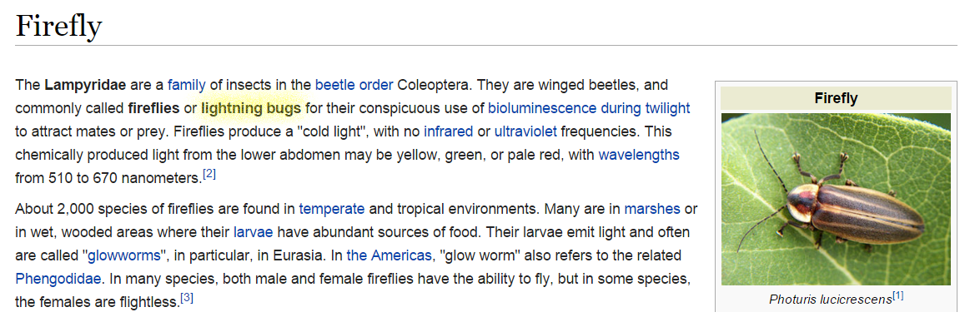
https://en.wikipedia.org/wiki/Firefly

Slide 7
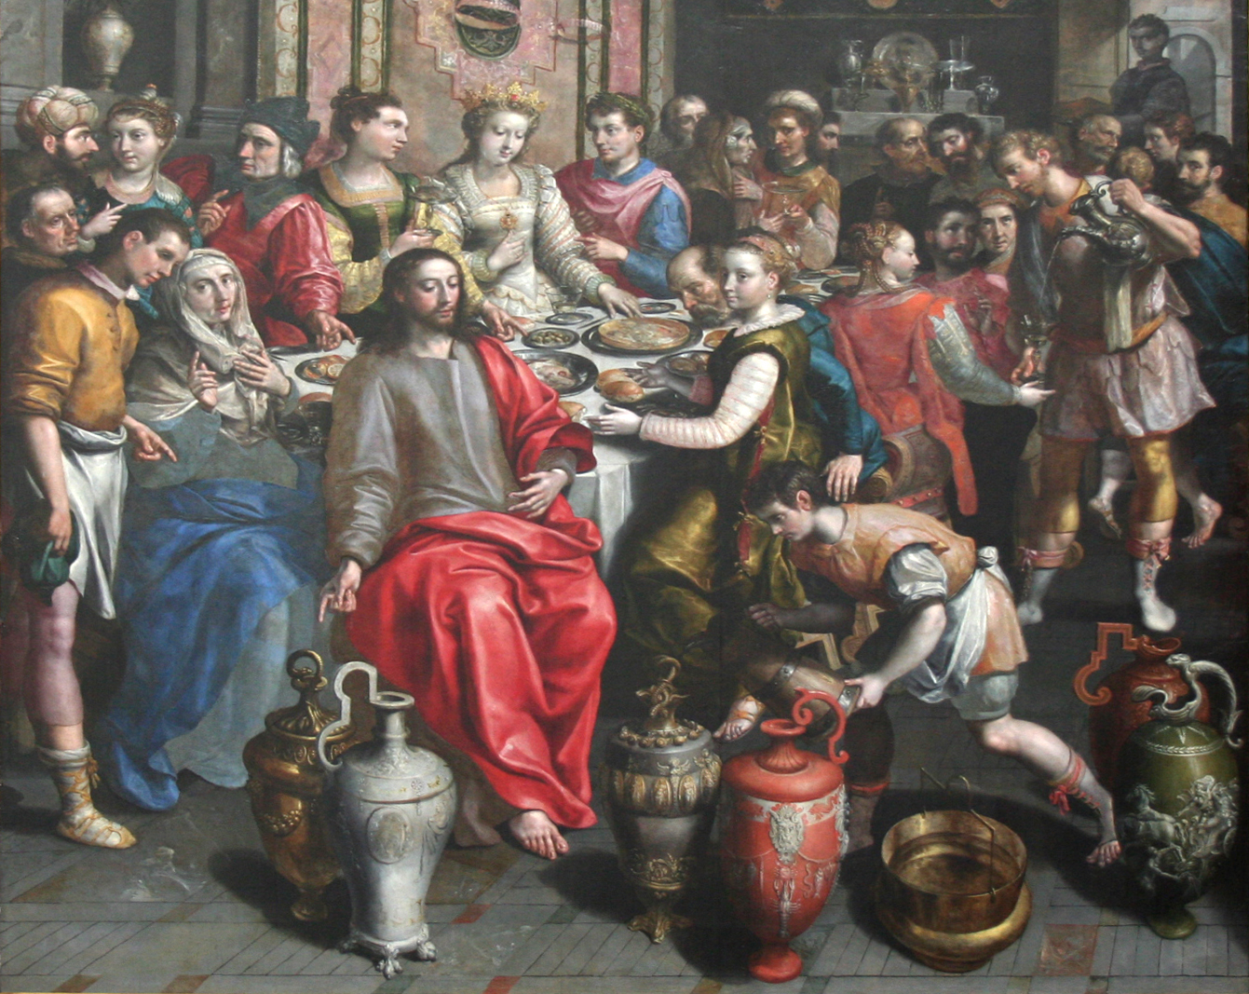
Change-Water -into Wine
Error : The term "Change-Water" ist not yet implemented.
Notes:
https://en.wikipedia.org/wiki/Marriage_at_Cana#/media/File:Maerten_de_Vos_-_Bruiloft_van_Cana.JPG

Slide 8
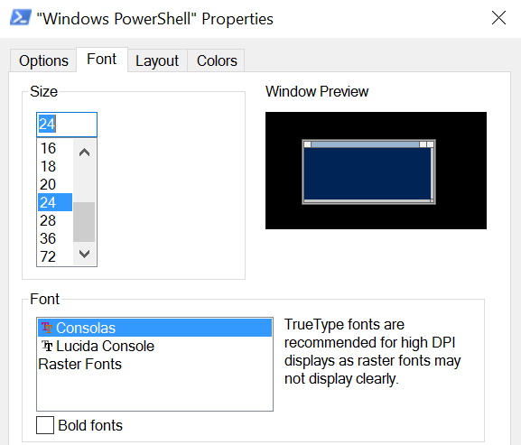
Basic tasks: Make it readable!
$Host.PrivateData.ErrorBackgroundColor = 'white'
$PSHOME\profile.ps1

Slide 9
What's a PowerShell command ?
[System.DateTime]::Now
Get-Date
date

Slide 10
The DNA of PoSh: Objects
# Integer # Object
1 Import-Csv -Path .\ducktown.csv
# String
'Donald'
# Boolean
$false
# Multiple items / Array
'Huey', 'Dewey', 'Louie'

Slide 11
The DNA of PoSh: Parameter binding
Drive-Car Lisboa
Drive-Car -destination Lisboa
Drive-Car -destination Lisboa -fast 60mph
Lisboa | Drive-Car

Slide 12
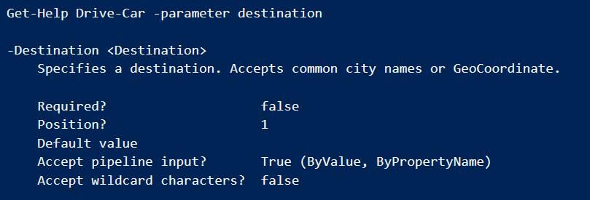
Parameter binding: byValue
Drive-Car -destination Lisboa
Lisboa | Drive-Car

Slide 13
Parameter binding: byPropertyName
'sea-dc1' | Test-Connection
ERROR

Slide 14
Basics
Demo 1

Slide 16
devs? ops?

Slide 17
What's your target audience, MOC?
Notes:
Page 02-11

Slide 18
Get-Shapes |
Where-Object {$_.Color –eq "Orange"} |
Sort-Object Size
http://technet.microsoft.com/en-us/library/ee176927.aspx

Slide 19
Get-Shape |
Where-Object {$_.Color –eq 'Orange'} |
Sort-Object –property Size -descending
✓
http://technet.microsoft.com/en-us/library/ee176927.aspx

Slide 20
[type] literals
$a = 1
$a = '1'
$a.GetType()
[int]$b = 1
$b = '1'
$b.GetType()
"PowerShell has no variable declaration statement.
In contrast to a language like Visual Basic, which uses
Dim to declare a variable, in PowerShell a variable simply comes into existence on first assignment."
Bruce Payette: PowerShell in Action, 2011

Slide 21
PowerShell mysticism: case preserving
# Scrooge
# Dagobert
'Scrooge Duck' -replace 'scrooge','dagobert'
('Scrooge Duck').replace('scrooge','dagobert')

Slide 22
Falling in love with external commands
whoami.exe /groups /fo csv |
ConvertFrom-Csv |
Where-Object {$_. 'Group Name' -like 'contoso*'} }
$src = 'c:\sales\2015'
$dst = 'c:\backup\sales\2015'
robocopy.exe /mir $src $dst

Slide 23
Pipeling, reloaded
$computers | ForEach {
Test-Connection -ComputerName $psitem}
ForEach ($computer in $computers) {
Test-Connection -ComputerName $computer }

Slide 24
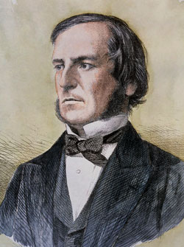
Mr. Bool and the evil [switch]
Get-NetFirewallRule -Enabled true
New-ADUser 'Donald' -Enabled $true
Remove-ADUser 'Donald' -Confirm:$false
Notes:
https://upload.wikimedia.org/wikipedia/commons/c/ce/George_Boole_color.jpg

Slide 25
Challenges
Demo 2

Slide 26
Survival Kit
1. Honor the DNA of PowerShell
2. Be precise
3. Keep it simple
4. Mind the gaps
4. Keep it small

Slide 27
Real \b(wo)?men\b
don't click.

